Slide 1
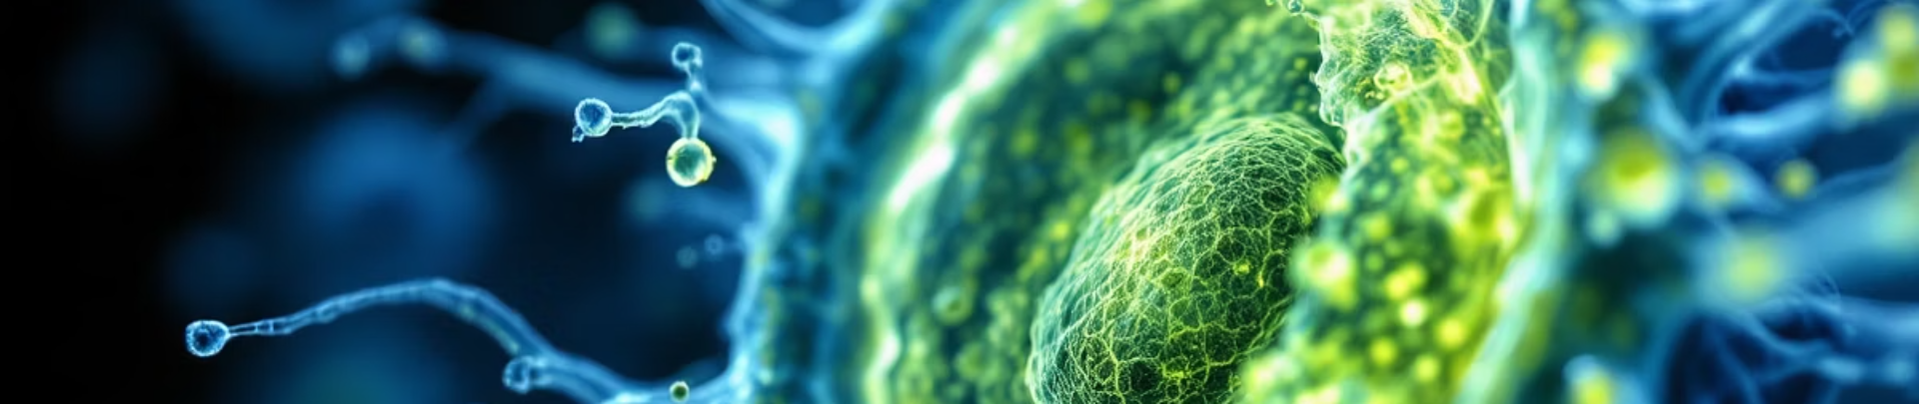
Annotation of Pathological Images using Fiji and QuPath
This presentation explores computational techniques in digital pathology.
By Sangeeth Varma S V, B Sc Biology (Hons.) 3rd year student, Banaras Hindu University.

Slide 2
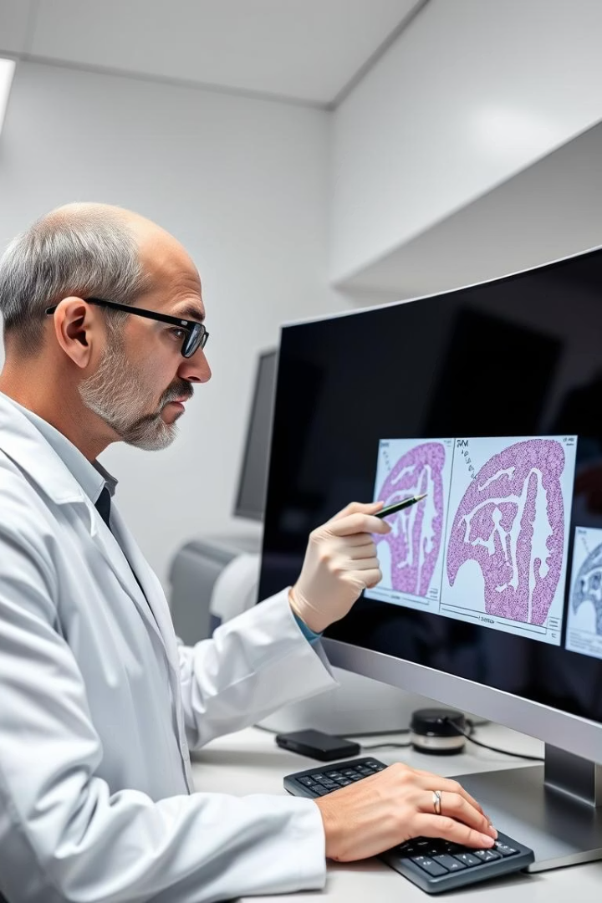
Introduction to Image Annotation
Importance
Applications
Essential for diagnostics and research accuracy
Supports AI model training and validation
Tools
Uses Fiji and QuPath for annotation workflows

Slide 3
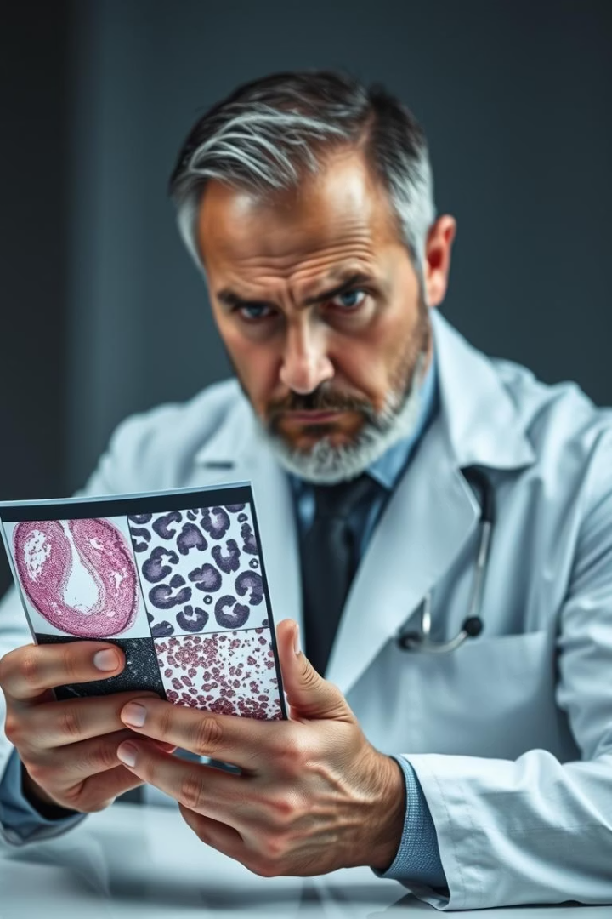
Challenges in Pathology Image Analysis
Time-Consuming
Manual slide analysis delays results
Subjectivity
High inter-observer variability affects consistency
Standardization
Need for reproducible annotation protocols
Data Scarcity
Limited annotated datasets for AI training

Slide 4
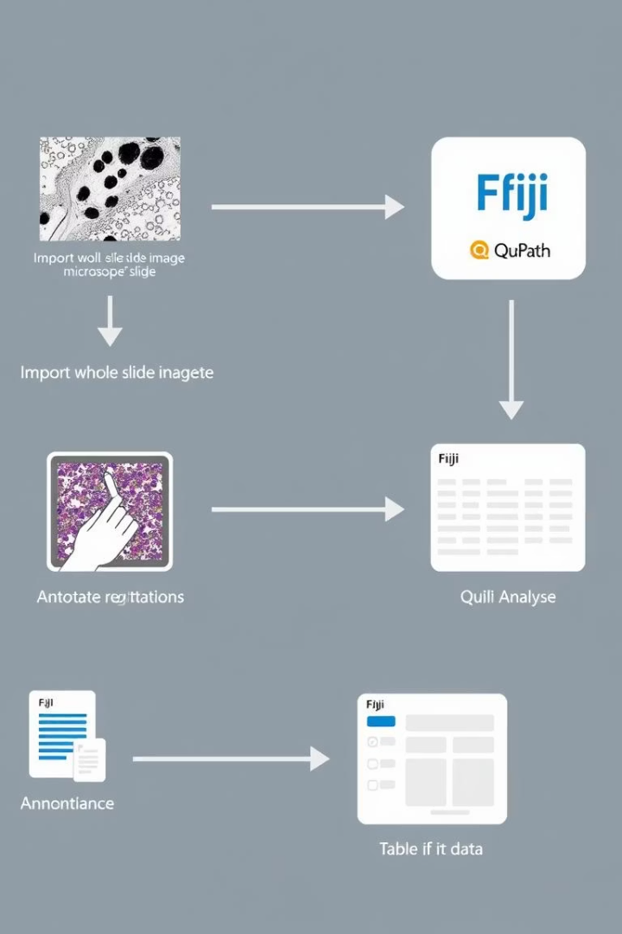



Project Objectives
Develop Annotation Workflow
Utilize Open-Source Tools
Support AI Model Development

Slide 5
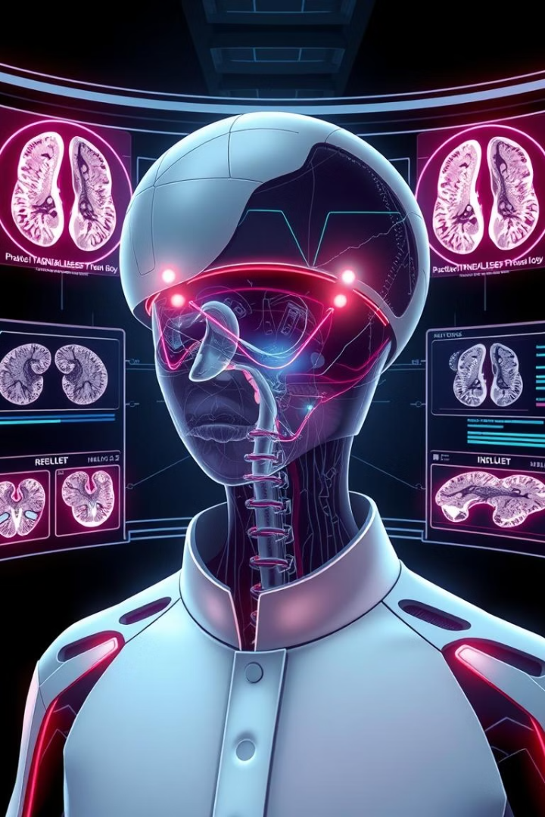




Overall Strategy
Annotate Images
Export ROIs and Masks
Train Segmentation Models
Iterate for Accuracy

Slide 6
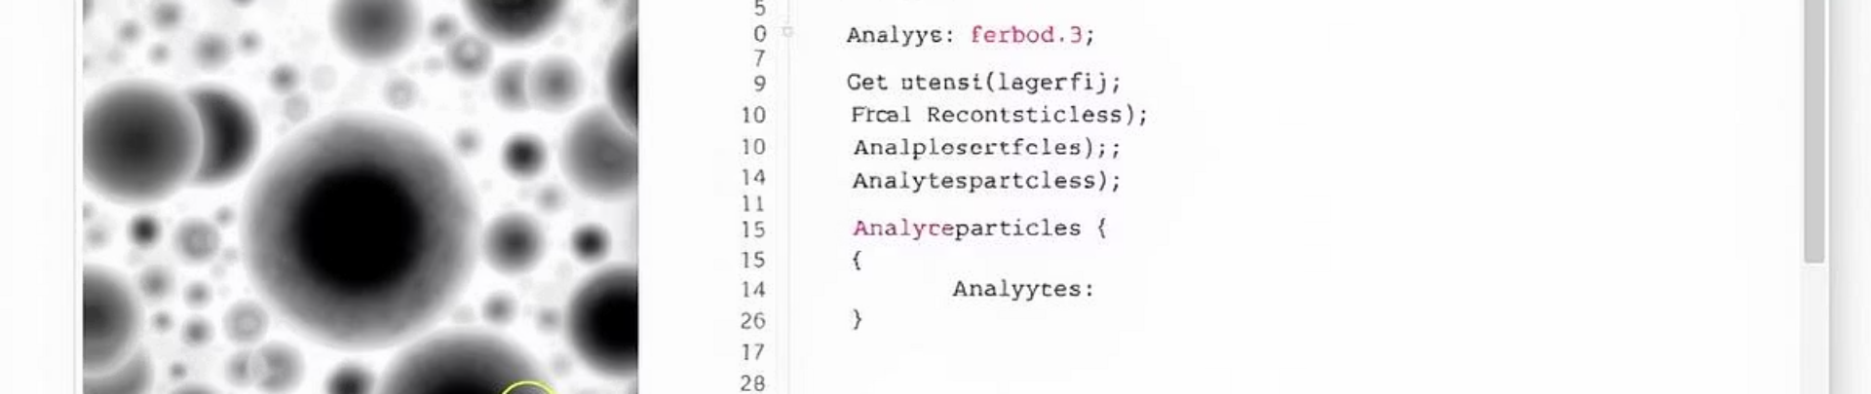
Fiji Tool Overview
Open-Source Platform
ROI Tools
Widely used for image analysis
Precise region selection and editing
Plugin Support
Macro Scripting
Extensible for diverse analysis needs
Automates repetitive tasks efficiently

Slide 7
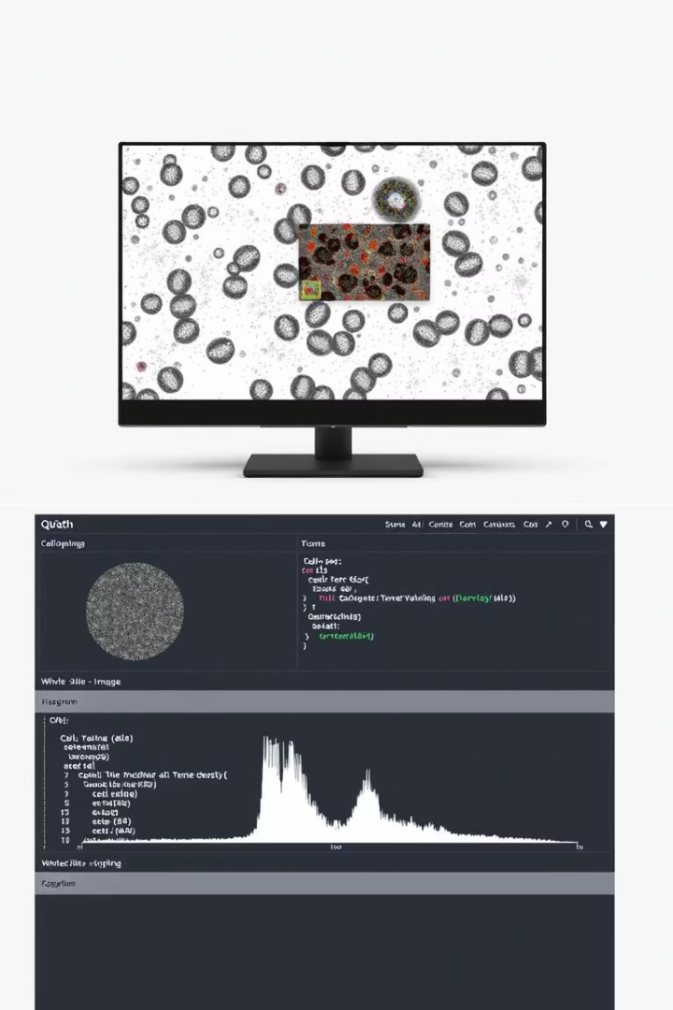
QuPath Tool Overview
Whole Slide Imaging
Optimized for large pathology slides
Annotation Tools
Intuitive drawing and labeling features
Object Classification
Enables cell and tissue classification
Scripting Capabilities
Facilitates customized workflows

Slide 8
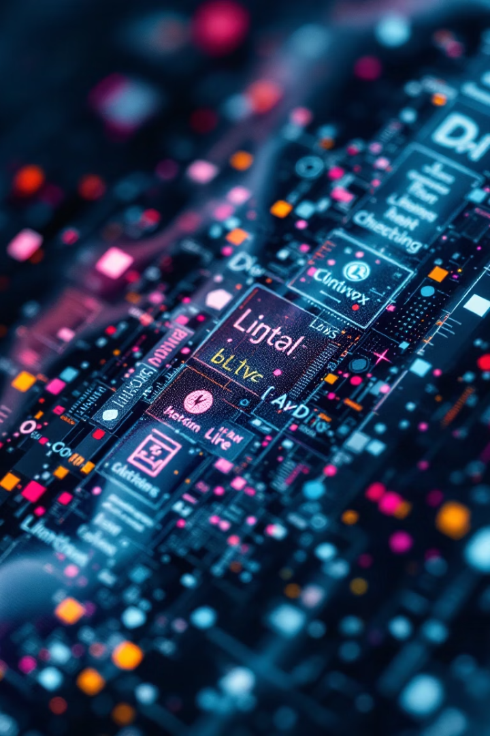
Image Annotation Workflow
Image Acquisition
Export ROIs/Masks
Import to QuPath
Fiji Processing (Optional)
Annotate Regions/Cells
Dataset Preparation

Slide 9
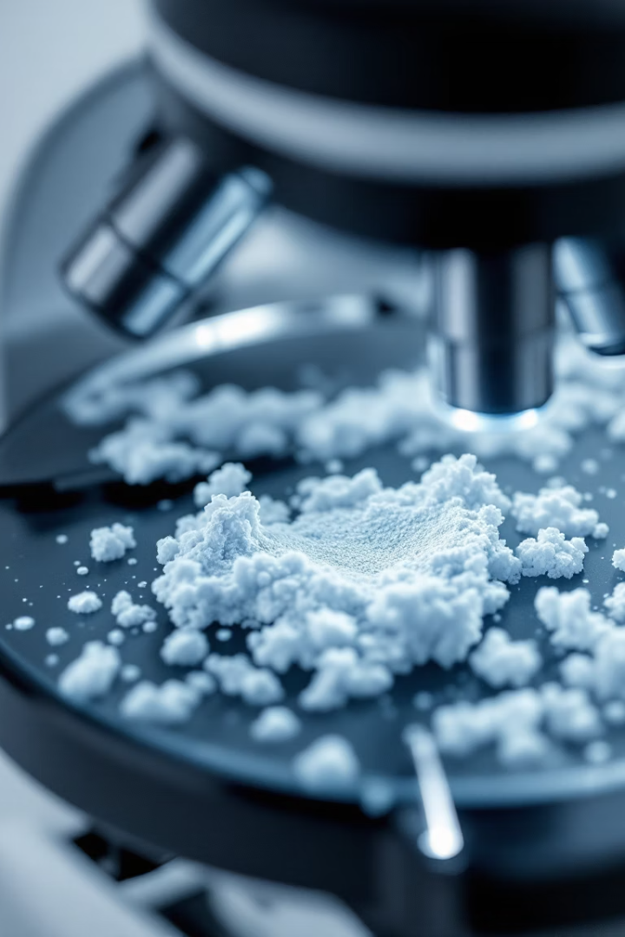
Step 1: Image Acquisition
Sources
Key Focus
Whole slide scanners
High resolution preserves detail
Microscope digital cameras
Image quality affects analysis accuracy

Slide 10
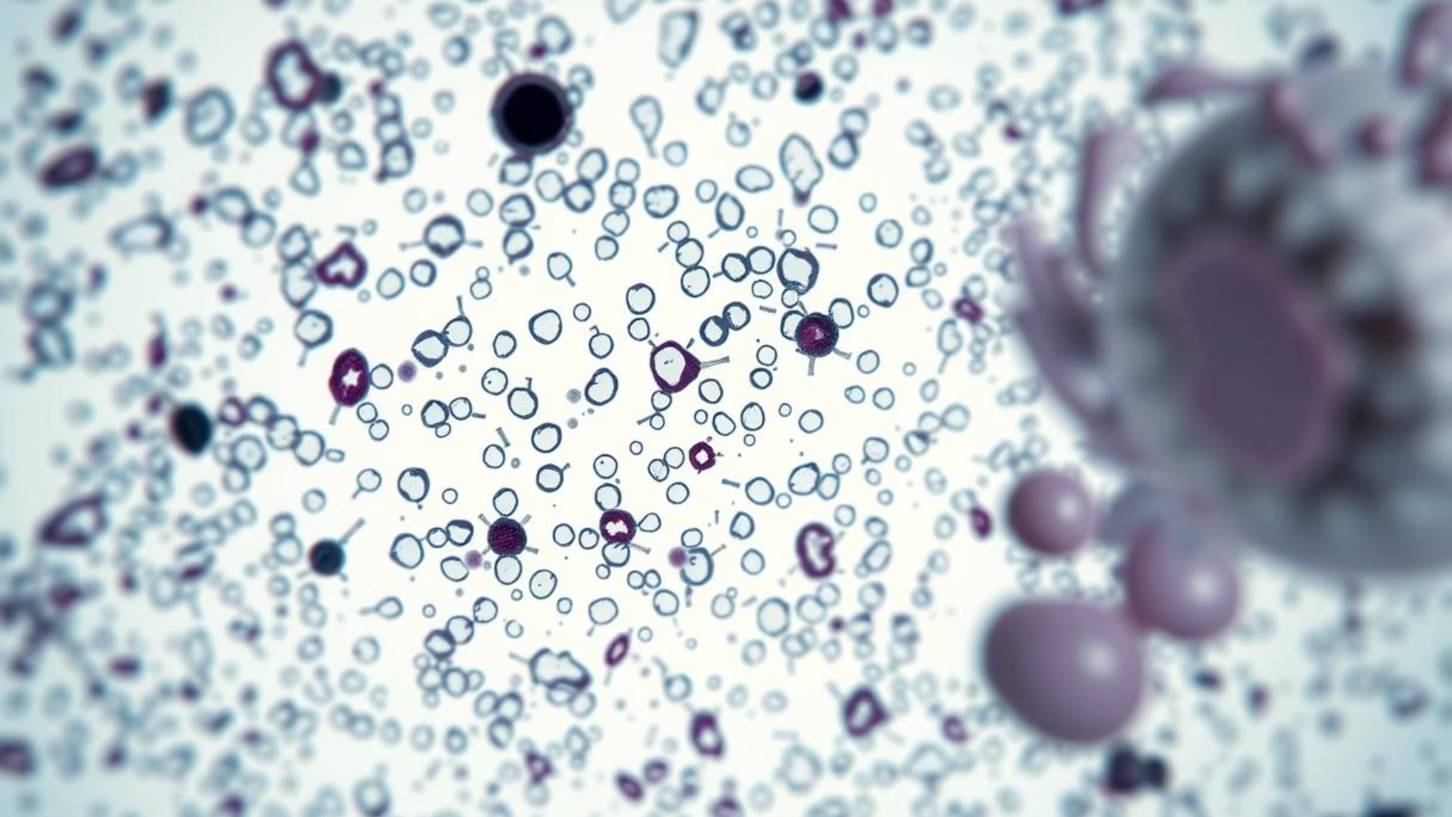
Step 2: Importing Images
Supported Formats
Large File Handling
.svs, .tiff, .ndpi compatible
Pyramid format enables efficient viewing
Flexible import options
Improves performance on large whole slide images

Slide 11
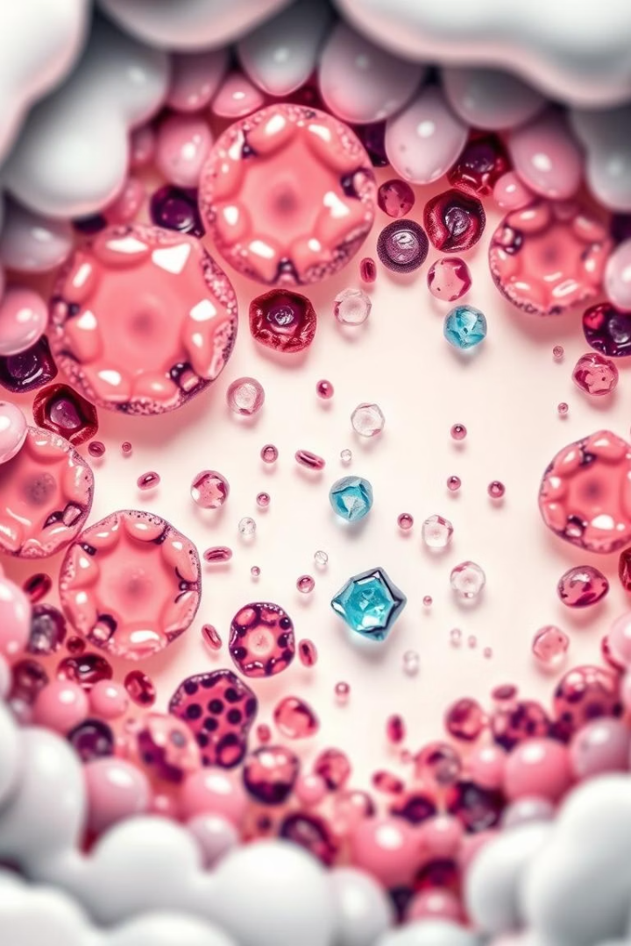
Step 3: Annotation in QuPath
1
Manual and automatic annotation for detailed labeling
2
Hierarchical object detection organizes tissue and cells
3
Classifiers differentiate diverse tissue structures accurately

Slide 12
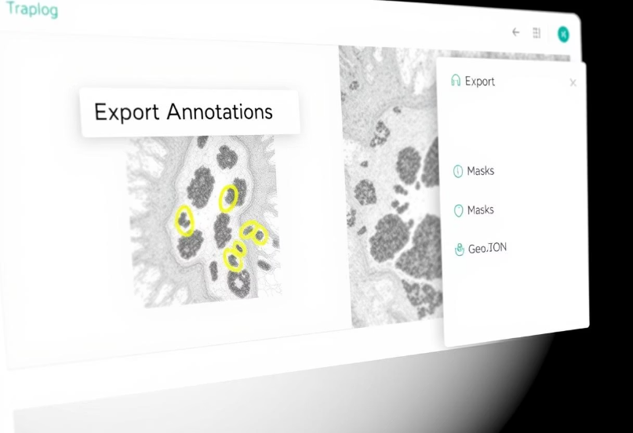
Step 4: Exporting Data
Export annotations as masks or GeoJSON files
Seamless integration with Fiji for advanced analysis
Facilitates accurate data transfer across tools
Prepares datasets for AI model training and validation

Slide 13
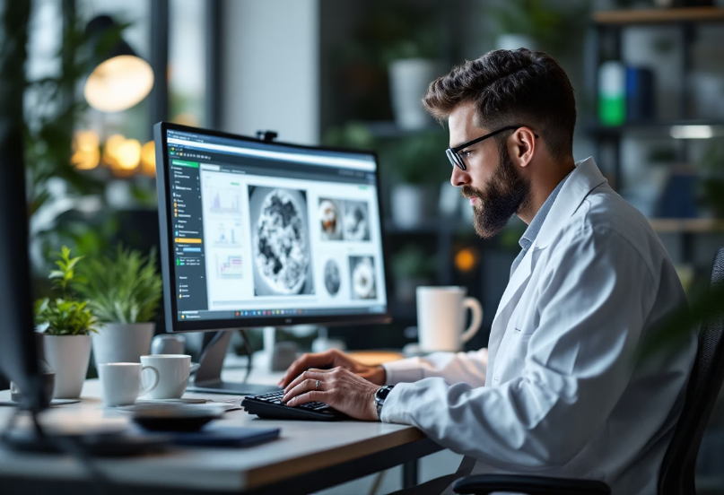
Step 5: Processing in Fiji
Apply filters and image enhancements to improve clarity
Measure intensities and morphological features precisely
Use macros to automate batch processing efficiently

Slide 14
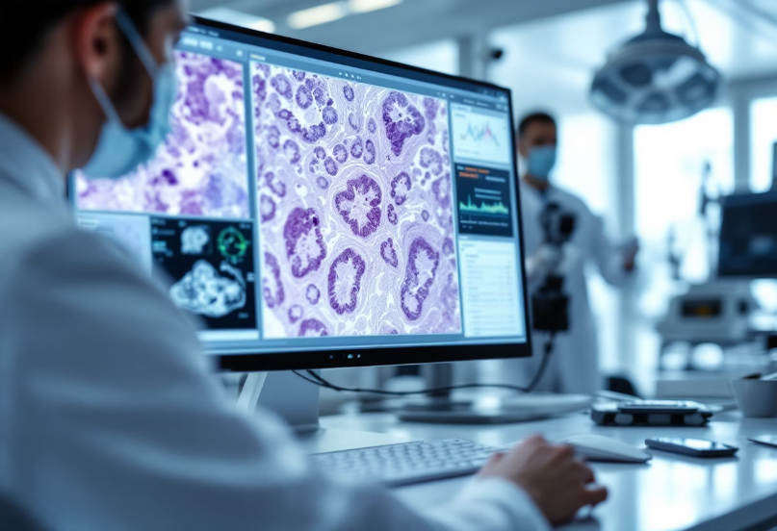
Step 6: Dataset Preparation
Organizing Annotated Data
Carefully structure exported annotations for smooth integration.
Formatting for AI Training
Prepare data in formats compatible with models like U-Net.
This step ensures accurate and efficient model learning.

Slide 15
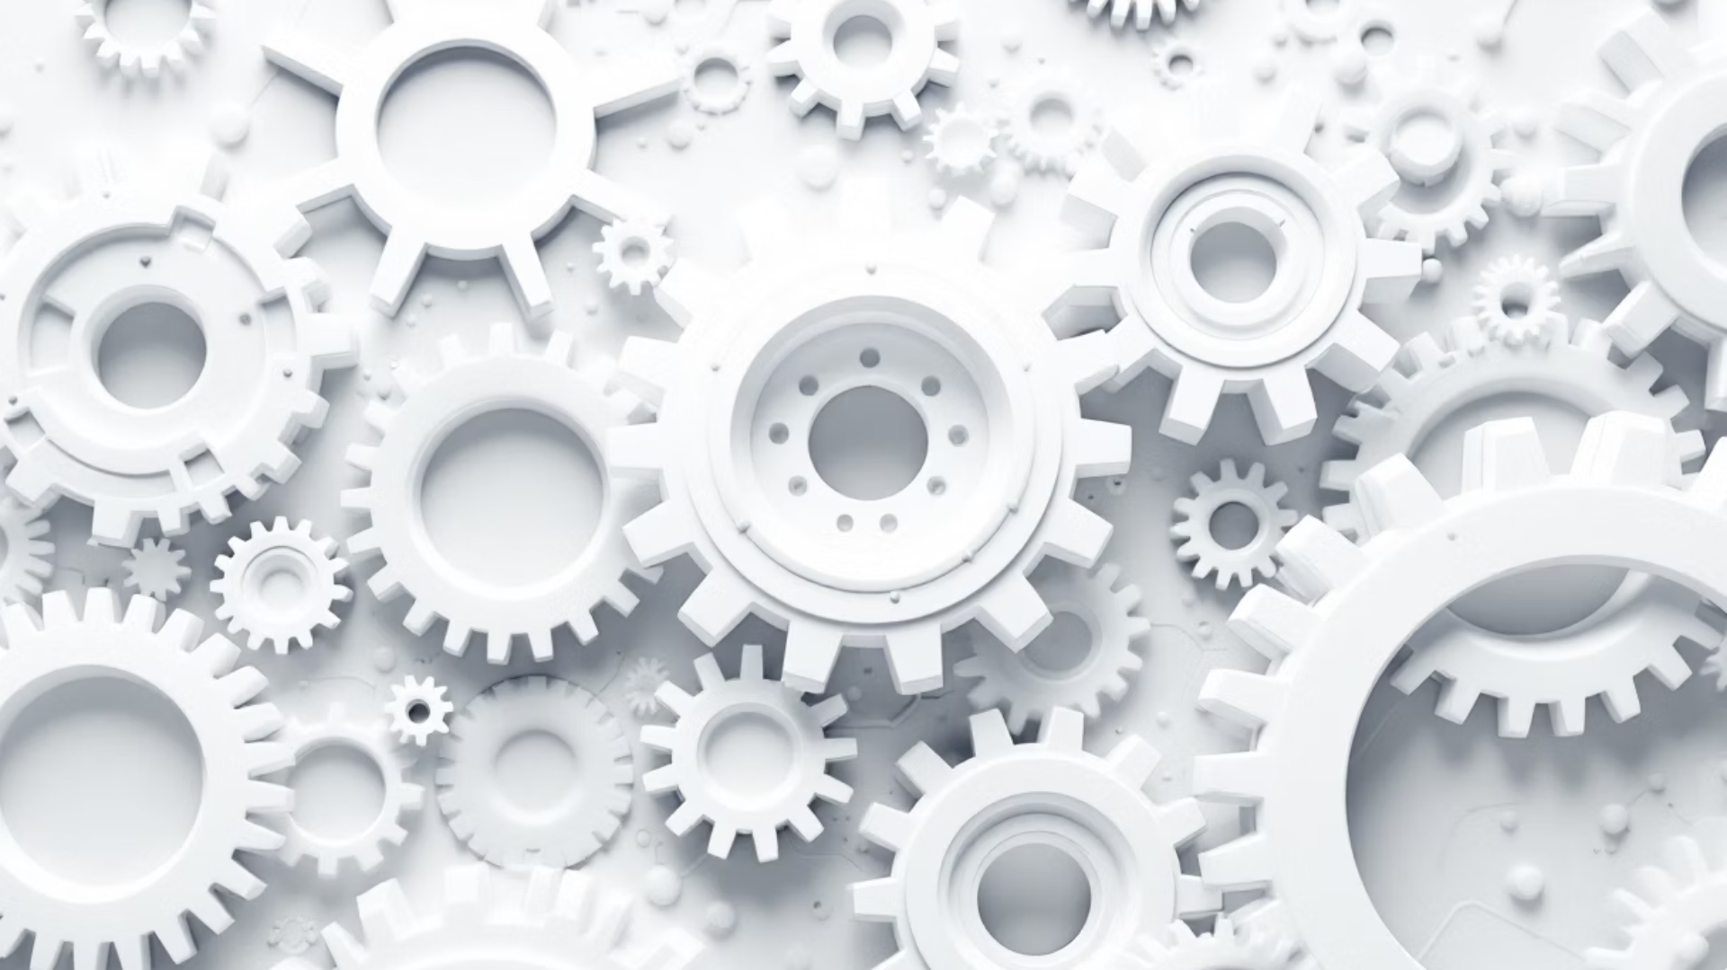



Challenges in Annotation
Inconsistent Staining
Variability in staining and sample preparation affects consistency
Subjective Interpretation
Subjective interpretation of tissue structures leads to discrepancies
Time-Consuming
Manual annotation is time-intensive and demands high expertise

Slide 16
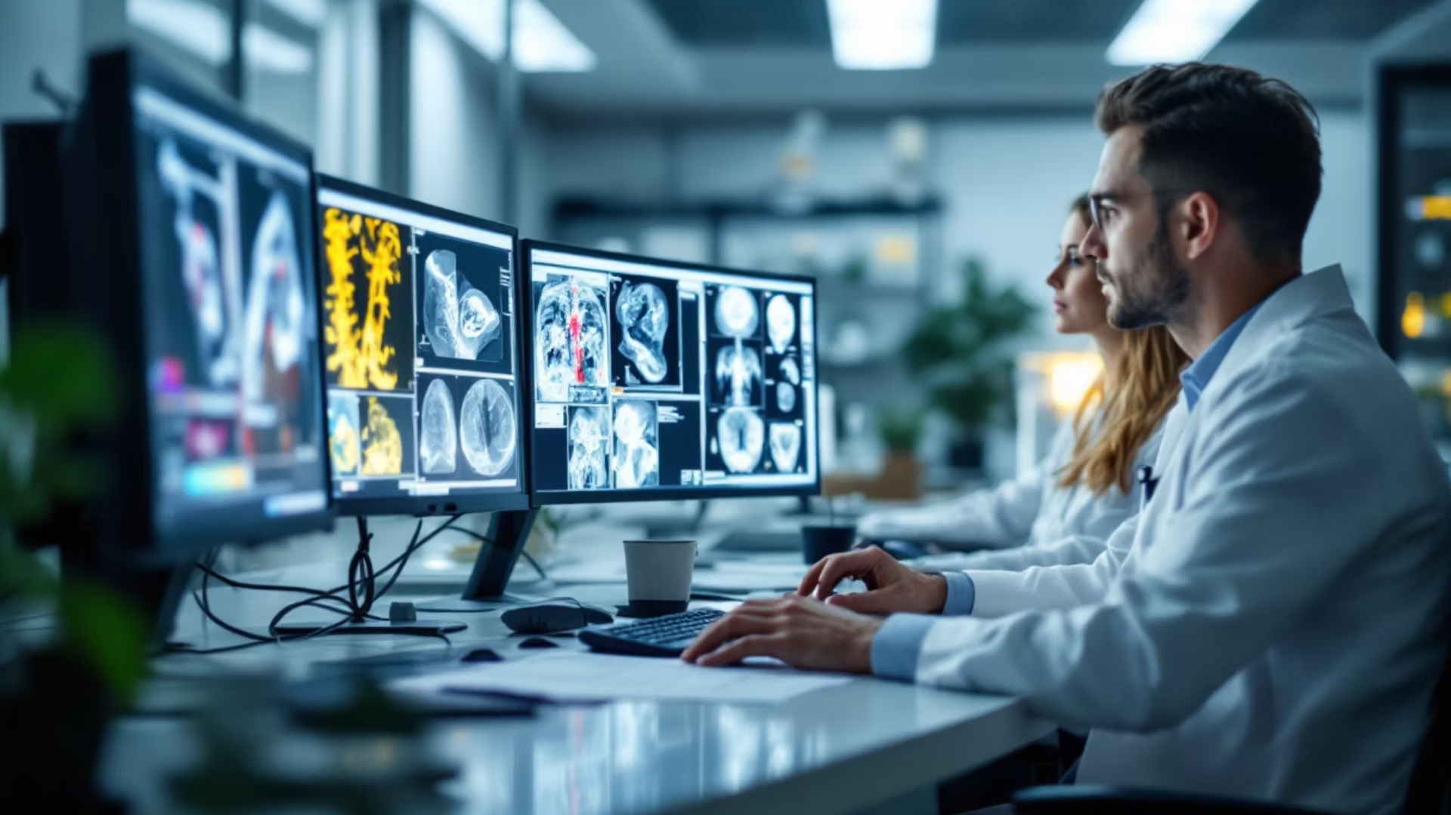
Solutions and Best Practices
Implement semi-automated annotation tools to boost efficiency
Establish consistent labeling guidelines for accuracy and uniformity
Encourage team-based review to improve annotation quality

Slide 17
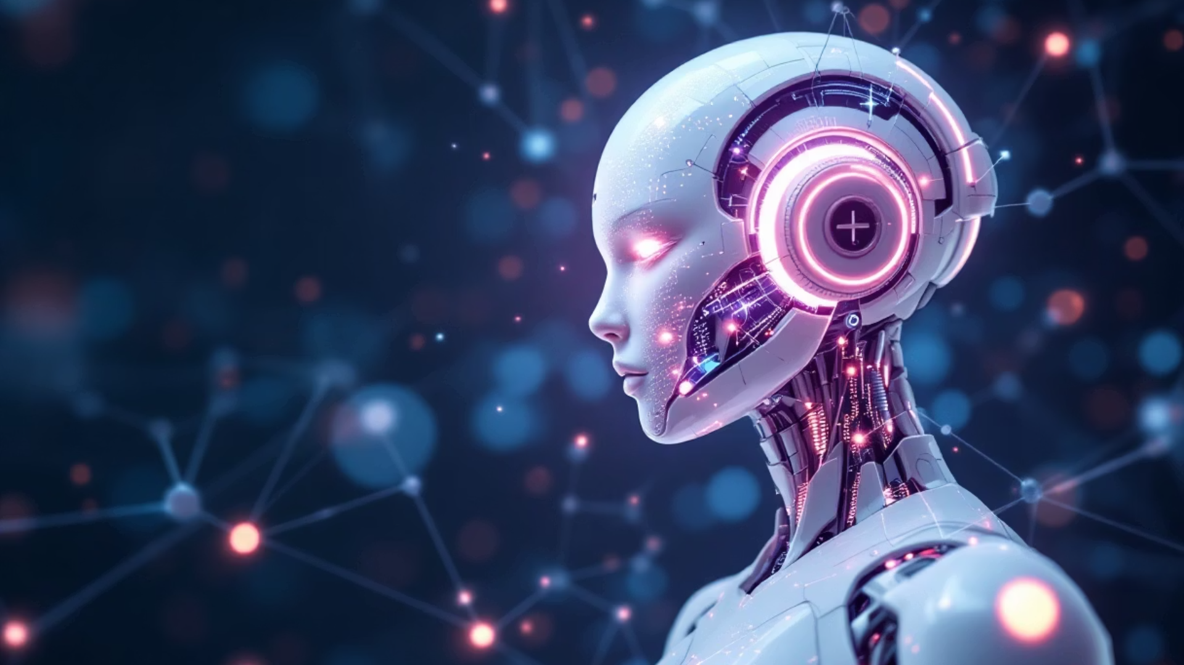
Future Scope
Enhance Automation
Improve Efficiency
Community Benefit
Integration with deep learning pipelines to enhance automation.
Use of active learning to improve annotation efficiency.
Development of public annotated datasets for community benefit.

Slide 18

Conclusion
Critical Role
Powerful Tools
Future Impact
Annotation enables meaningful computational analysis of pathology images.
Fiji and QuPath provide accessible, standardized image annotation solutions.
These platforms fuel AI-driven diagnostics and enhance research capabilities.

Slide 19
References
Key references provide foundational knowledge for image annotation in pathology.
Bankhead et al. (2017) discuss advanced analysis methods in Scientific Reports.
Schindelin et al. (2012) detail Fiji/ImageJ’s capabilities in Nature Methods.
Official documentation offers practical guidance: QuPath Docs and Fiji/ImageJ Docs.

